Slide 1

Department of Cyber Security 2026-2027- Odd Semester
III Year /V Sem
CS23533-FOUNDATIONS OF ARTIFICIAL INTELLIGENCE
Zeroth Review – 31.07.2026

Slide 2
Adversarial State-Space Optimization in Chess Environments
Batch Members :
Baviri Setty Sai Deevan - 241901016
Monish Priyan M - 241901057
Supervisor: Dr. S.Bhuvana
Assistant Professor[SG]

Slide 3
OUTLINE
Abstract
Objective
Literature Survey
Summary of Literature
Proposed System & Novelty
Block Diagram
Hardware/Software requirements
References

Slide 4
ABSTRACT
Chess is modeled as a fully observable, deterministic, adversarial state space rather than a learned problem, so the engine relies entirely on classical AI search rather than machine learning.
A goal-based intelligent agent defines the chessboard as states, actions, and transition functions, forming the problem-solving foundation of the system.
A hand-crafted evaluation function encodes chess knowledge — material value, positional strength, mobility, and king safety — for static position assessment.
Minimax with Alpha-Beta Pruning optimizes traversal of the exponentially large game tree by eliminating branches that cannot affect the final decision.
Iterative Deepening and Quiescence Search extend the algorithm to search within a fixed time budget while avoiding the horizon effect at unstable positions.
The system outputs the optimal move along with search depth, nodes expanded, and evaluation score — demonstrating state-space optimization in a real adversarial environment.

Slide 5
OBJECTIVE
To design and implement a fully self-built chess engine using only classical AI search techniques, without any machine learning component.
To model the chessboard as a formal state-space search problem consistent with intelligent-agent theory.
To implement Minimax search enhanced with Alpha-Beta Pruning to optimize traversal of
the adversarial game tree.
To reduce the effective branching factor through move ordering, transposition tables,
and iterative deepening.
To design a hand-crafted heuristic evaluation function capable of guiding depth-limited
search decisions.
To validate the correctness of move generation and search logic through systematic
testing (perfect validation).
To provide an interactive visual interface so the engine's decisions and search statistics can be observed in real time.

Slide 6
Literature Survey
TITLE | YEAR | AUTHOR | TECHNIQUE
Programming a Computer for Playing Chess | 1950 | Claude E. Shannon | Minimax search over a game tree
Deep Blue | 2002 | M. Campbell, A. J. Hoane Jr., F. Hsu | Parallel Alpha-Beta search with custom hardware move generation and hand-tuned evaluation
Efficient Selectivity and Backup Operators in Monte-Carlo Tree Search | 2006 | Rémi Coulom | MCTS as an alternative to minimax for game-tree exploration

Slide 7
EXISTING SYSTEM
Deep Blue (IBM, 1997) relied on custom VLSI hardware for move generation combined with parallellised Alpha-Beta search and ~8,000 hand-tuned evaluation features.
Stockfish, a leading modern open-source engine, combines classical Alpha-Beta search with an efficiently updatable neural network (NNUE) for evaluation — a hybrid rather than purely classical approach.
AlphaZero (DeepMind) replaces hand-crafted evaluation entirely with deep
reinforcement learning and neural-network-guided Monte Carlo Tree Search.
Many academic/student chess engine projects depend on external libraries (e.g., python-chess) for move generation, limiting the depth of AI concepts actually implemented by the student.
Rule-based engines without move ordering or transposition tables suffer from poor Alpha-Beta pruning efficiency and cannot search competitively within reasonable time limits.
Basic command-line chess programs typically lack any visual interface, making the search
process and decision-making opaque to the user.

Slide 8
PROPOSED SYSTEM
A fully self-built board representation and legal move generator (including castling, en passant, and promotion) implemented from first principles, without any external chess library.
A Minimax search engine reformulated as Negamax, combined with Alpha-Beta Pruning to eliminate branches that cannot influence the final decision.
Move ordering (MVV-LVA heuristic and transposition-table best-move lookup) to maximize
pruning efficiency at each search depth.
A Transposition Table using Zobrist hashing to avoid re-searching previously encountered positions reached via different move orders.
Quiescence Search to extend evaluation through capture sequences, avoiding the horizon effect
at tactically unstable positions.
Iterative Deepening to progressively increase search depth within a fixed time budget, ensuring a
valid move is always available.
A hand-crafted evaluation function scoring material, piece-square positional tables, mobility, king safety, and pawn structure.

Slide 9
Novelty in Proposed System
Unlike most student projects that depend on external chess libraries for move
generation, this system implements the entire rules engine from scratch, giving full
control and transparency over every AI component.
Correctness of move generation is formally validated using the Perft testing method,
matching published reference node counts exactly — a rigorous verification approach
rarely used in course-level projects.
The system exposes its internal reasoning process live (search depth, nodes expanded,
evaluation score) rather than treating the engine as a black box, making the classical AI decision-making process observable and explainable.
A dual implementation strategy (Python for logic clarity, JavaScript for interactive
deployment) allows the same validated algorithm to run both as a standalone research
artifact and as a real-time playable interface.
The evaluation function and search enhancements are modular and independently
tunable, allowing direct experimental comparison of pruning efficiency, move-ordering
impact, and search-depth tradeoffs.

Slide 10
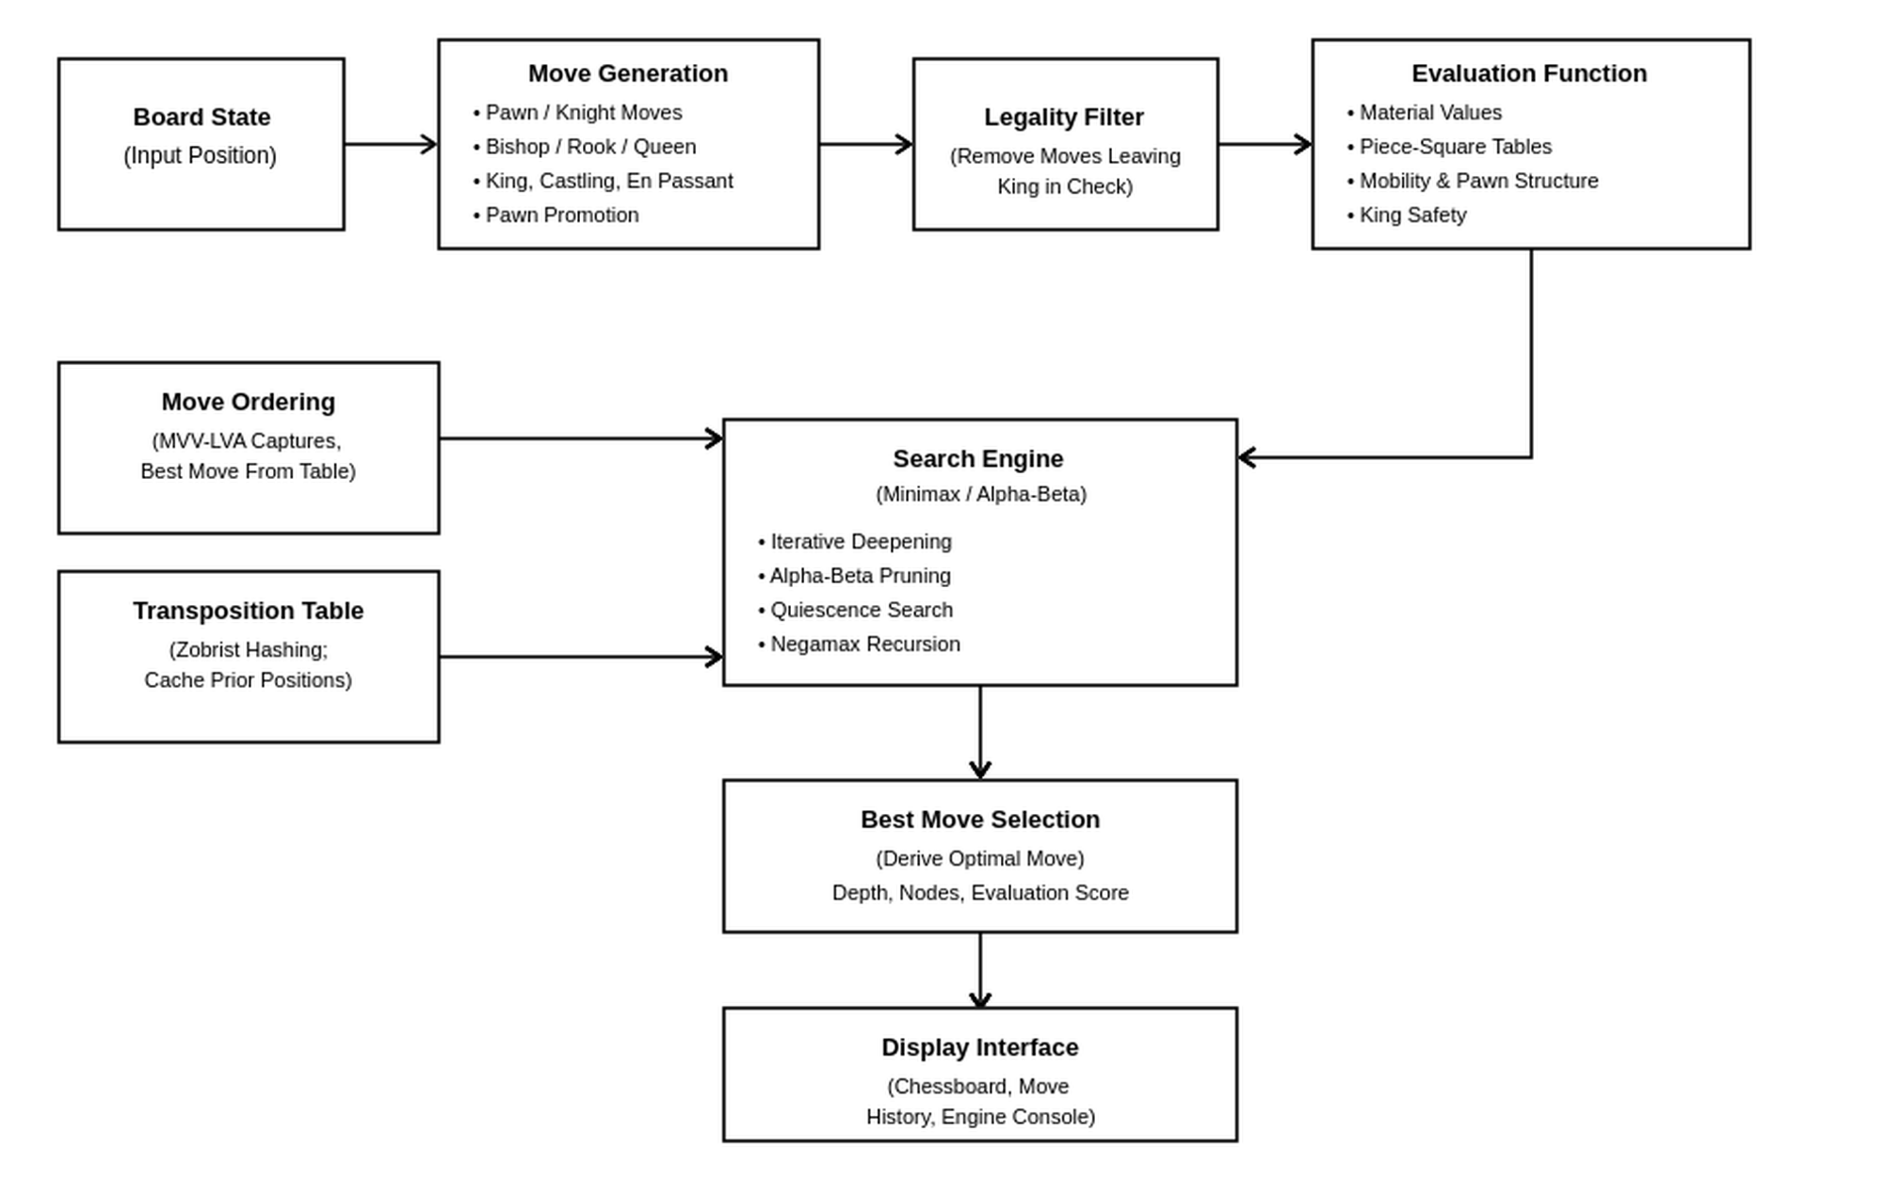
BLOCK DIAGRAM(PROPOSED SYSTEM)

Slide 11
Hardware/Software Requirements
Hardware Requirement:
Standard PC/laptop with Intel i3 processor or above
Minimum 4 GB RAM (8 GB recommended for deeper search depths)
No GPU required (classical AI — no machine learning training involved)
Software Requirement:
Python 3.x (core engine implementation)
JavaScript (ES6) and a modern web browser (for the interactive visual interface)
Visual Studio Code or any Python-compatible IDE
Git for version control

Slide 12
References
Shannon, C. E. (1950). Programming a Computer for Playing Chess. Philosophical
Magazine, Series 7, 41(314).
Campbell, M., Hoane, A. J., & Hsu, F. (2002). Deep Blue. Artificial Intelligence, 134(1-2),
57-83.
Coulom, R. (2006). Efficient Selectivity and Backup Operators in Monte-Carlo Tree
Search. Computers and Games.
Russel, S., & Norvig, P. (2020). Artificial Intelligence: A Modern Approach (4th ed.).
Pearson. – Chapters on Adversarial Search and Games.

